Slide 1

Graduation Project 2
Gas Leakage Detection System Based on IoT

Slide 2

Introduction
The Internet of Things (IoT) has achieved widespread connectivity with billions of instances worldwide.
Remote gas leakage monitoring, detection, and alerting are growing in importance due to increasing reliance on technology for work and daily event management.

Slide 3
Objectives and Scope
The main objective of developing a gas leakage detection system is to have a safe environment always by fast detecting gas leakage and taking automatic actions such as sending alerts, notifying the user, and turning on the CPU fan.
By detecting gas leaks, we are saving the lives of people and reducing the time it takes to refresh the air when there are children or people with special needs by taking automatic actions instead of manual ones.

Slide 4
Purpose of Our Project
Implement a system that constantly checks if a gas leak is occurring, if so, it will take all necessary steps to solve it and integrate it with the Internet of Things.
As a result of our project, we believe that suffocation cases will decrease, and lives will be saved Inshallah.

Slide 5
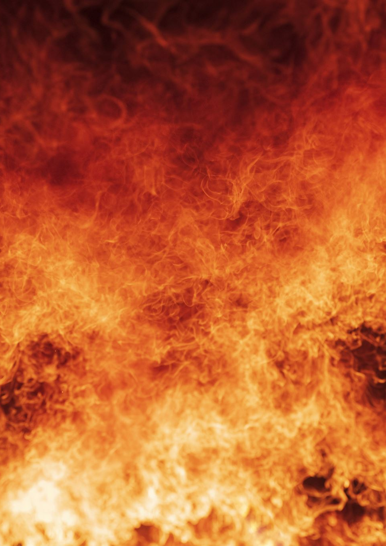
Gas Leakage Issues and consequences
The leakage of gas is a significant problem on its own.
Leakage of gas causes a great deal of damage in many different aspects, including property damage, environmental pollution, and human deaths.
People are always afraid of gas leakage because one mistake can cause huge damage.

Slide 6
Limitations and Solutions

Slide 7
Limitations
The distance between the gas source and the sensor.
Traditional gas leakage detection systems typically have a primary action, which is to alert or notify
Gas levels were not easily read and acted upon by people with special needs using old methods.

Slide 8
Solutions
Our project has integrated all segments of society by taking actions in multiple ways.
Our project replaced a lot of wired components into wireless components, which helps the user to place it in different places

Slide 9

Hardware Components

Slide 10
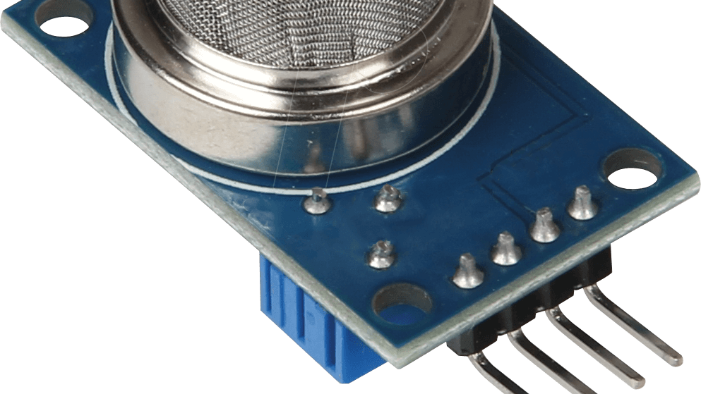
MQ2 Sensor
MQ2 Sensor: we used the analog input pin instead of digital input pin to be able to sense various levels of gas depending on different environments, such as industrial, domestic, etc..
MQ2 sensor is the best choice for our needs in Jordan.

Slide 11
ESP32
A microcontroller.
We used it instead of different Arduino types because it contains a built-in Wi-Fi, Bluetooth and we can improve our project without a need to change it.
It collects analog data and converts it into digital data.

Slide 12
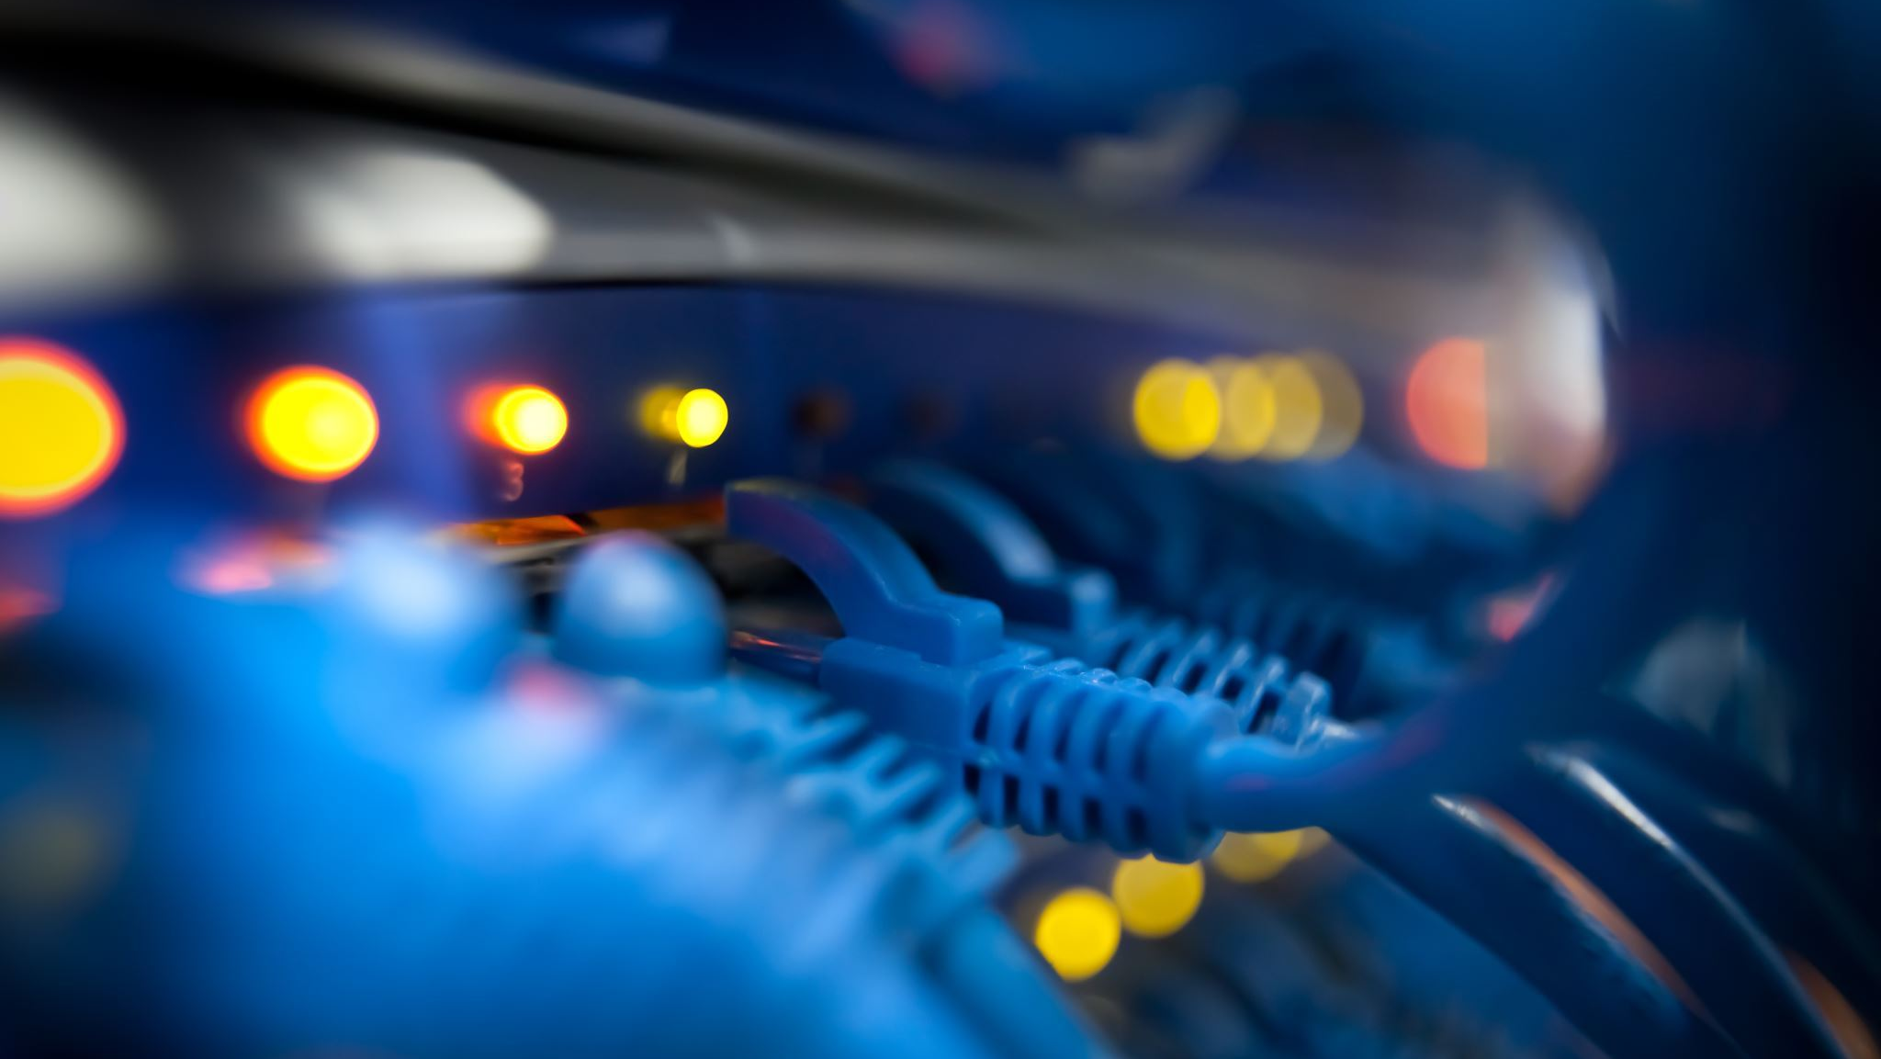
Other components
We used LED lights to notify people especially deaf people.
We used SFM buzzer to notify for people especially for blind people
We used CPU fan to kick-out the polluted air automatically

Slide 13

Software
Blynk Application: used to monitor the system through real-time gauge to read gas level and has notifying part.
Twilio: cloud communications platform that provides building communication-related features into applications.

Slide 14
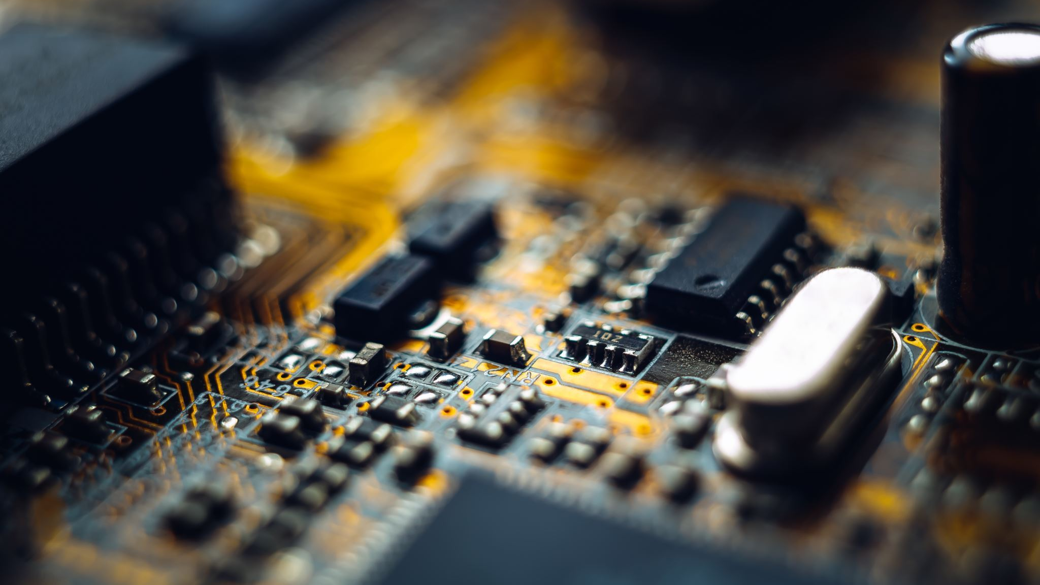
Implementation
In report we mentioned that we will use a transformer circuit to use 12-volt CPU fan, instead we used 5-volt CPU fan because it's easier to use and simpler.
Regarding to SIM800L we used a virtual phone number to reduce expenses because of the renewing subscription of any SIM card in Jordan is expensive.
In general, our project based on Esp32. It is the core of our project MQ2 sensor start sensing gas and send the data to the ESP32 then ESp32 sends a signals to notify, alert the user and start taking actions.

Slide 15
Design Requirements

Slide 16
Design Requirements
To achieve the goal of developing an efficient and reliable gas leakage detection system that aims to do 3 main actions (detect, alert and take actions), the project needs to fulfil the following design requirements.
Accuracy and Reliability
Real-time Monitoring
Communication and Data Integration

Slide 17
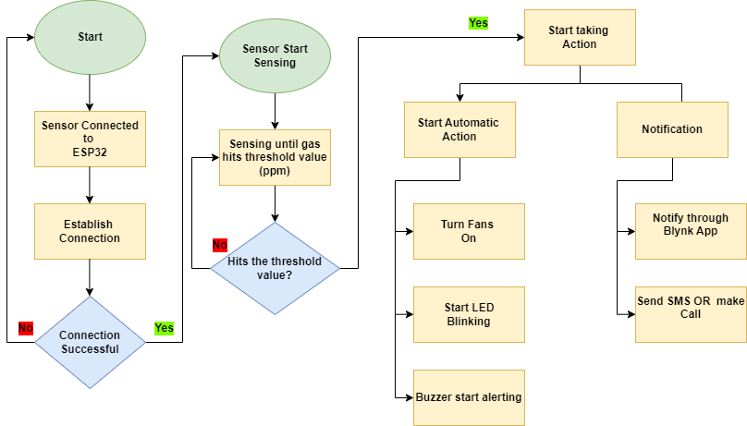
Design Flow Chart

Slide 18
Trial-and-error approach
MQ2 sensor has 2 reading options digital and analog. So, by using analog data reading pin, we used trial-and-error approach to determine the suitable threshold and distance.
This approach is the best approach we can use due to quick response we need.

Slide 19
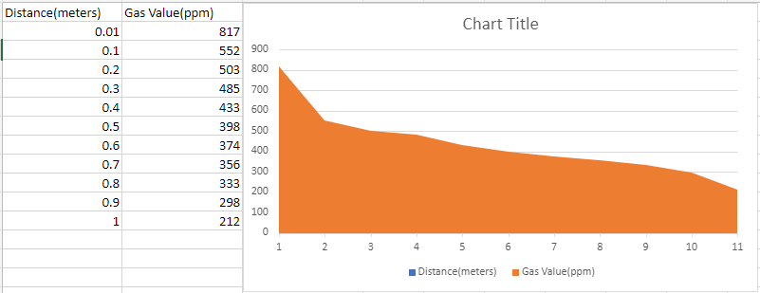
Trial-and-error approach

Slide 20
Realistic Constraints
Economic Constraints
Environmental Constraints
Manufacturability and Sustainability Constraints

Slide 21
Economic Constraints
Bandwidth Consumption
Memory Footprint
Cost Considerations

Slide 22
Environmental Constraints
Battery and Power Consumption
Energy Efficiency

Slide 23
Manufacturability and Sustainability Constraints
Final Product Dimensions and Weight
Materials and Components

Slide 24
Conclusion
Successful Functionality
Optimal Cost-efficiency
Continuous Improvement
Stakeholder Satisfaction
Ethical Considerations

Slide 25
Conclusion (Contd..)
In conclusion, our project stands as a testament to our dedication to saving lives through cost-effective means. Its successful implementation, utilization of optimal components, and consideration of ethical implications demonstrate our commitment to excellence. By continuously improving and prioritizing stakeholder satisfaction, we aim to make a lasting impact on the well-being of individuals and communities.

Slide 26
References
https://www.pololu.com/file/0J309/MQ2.pdf
https://roboeq.ir/files/id/4034/name/ESP32%20MODULE.pdf/
https://www.kwtss.com/wpcontent/uploads/2020/05/SFM27-buzzer-Datasheet.pdf
https://www.makerhero.com/img/files/download/Datasheet_SIM800L.pdf
https://www.farnell.com/datasheets/1498852.pdf
https://docs.blynk.io/en/
https://wiki.seeedstudio.com/Grove-Gas_Sensor-MQ2/
https://en.wikipedia.org/wiki/San_Bruno_pipeline_explosion
https://en.royanews.tv/news/18538/2019-08-29
https://www.dataversity.net/brief-history-internet-things/
https://randomnerdtutorials.com/getting-started-with-esp32/
https://lastminuteengineers.com/sim800l-gsm-module-arduino-tutorial/
https://lastminuteengineers.com/mq2-gas-senser-arduino-tutorial/
https://docs.blynk.io/en/blynk.apps/overview
https://en.wikipedia.org/wiki/Trial_and_error

Slide 27
Demonstration and Code
Finally, I wish you an enjoyable viewing experience of our project's demonstration video.
https://drive.google.com/drive/folders/14Zxkd3-7kNmE7QlZ7eBIeFKhRljL0aly?usp=sharing
Here's the link of our code
https://drive.google.com/file/d/1k0RAAjyfBuWh_rGydkGtpvmRooSpLCYo/view?usp=sharing

